Slide 1
Financial Analytics
By Ayesha Fatima

Slide 2
Problem Statement
Without analyzing the competition, it is difficult for a business to survive. You are tasked to analyse the competition for the management to provide better results. This data set has information on the market capitalization of the top 500 companies in India.

Slide 3

Introduction
I completed this project using Python. The data had a few missing values, which I first handled, and then I worked on deriving meaningful insights.

Slide 4
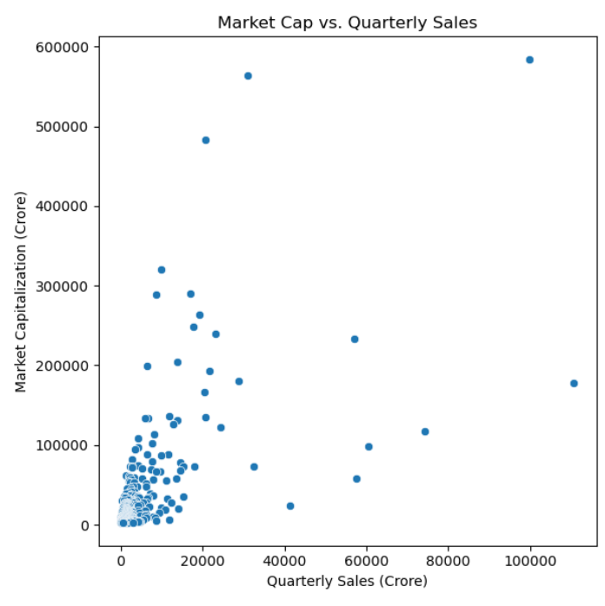
Visualizations

Slide 5
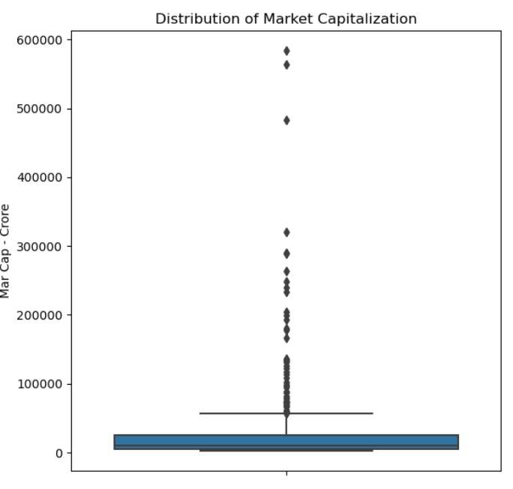
Here’s the distribution of market capitalization

Slide 6
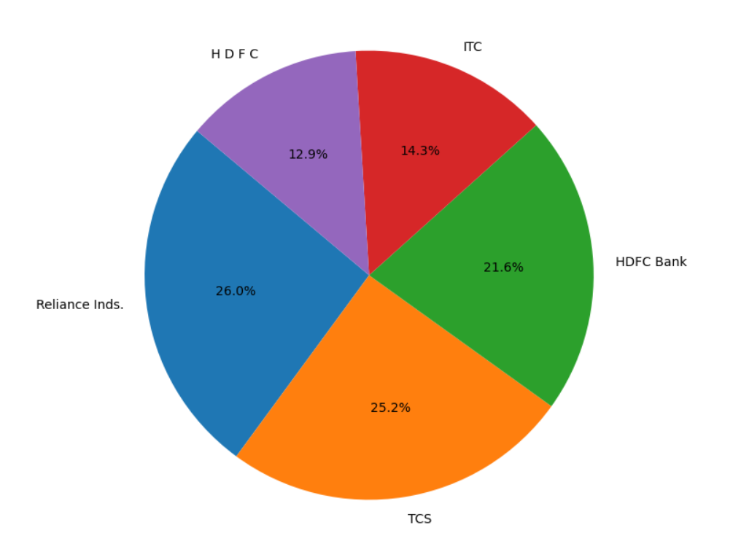
Top 5 companies by market capitalization
Reliance inds
TCS
HDFC Bank
ITC
H D F C

Slide 7
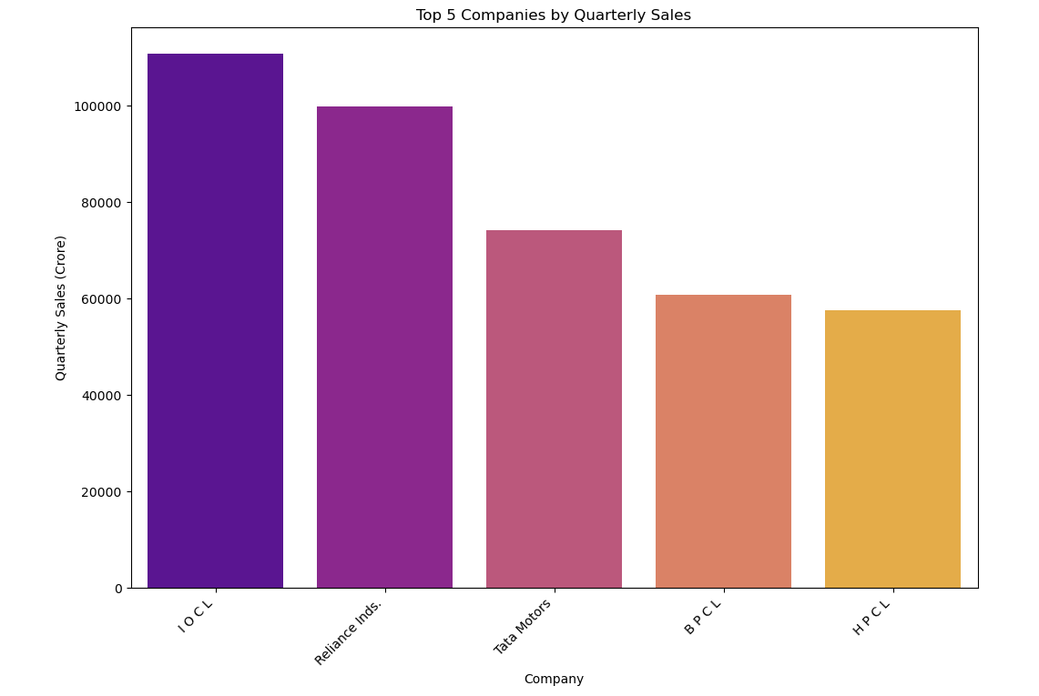
Top First Is IOCL

Slide 8
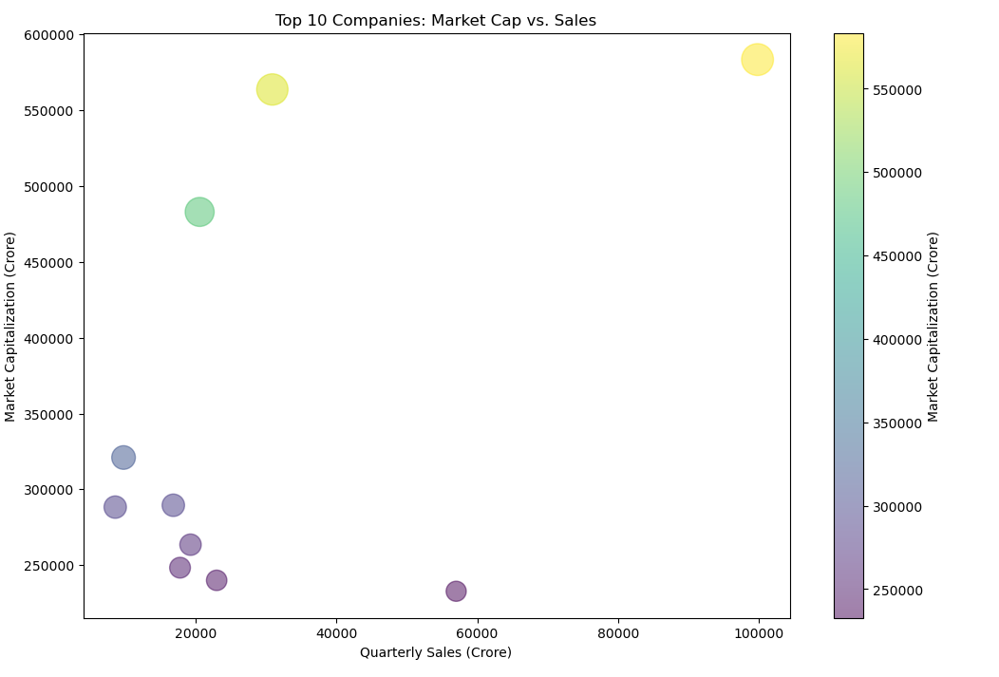

Slide 9
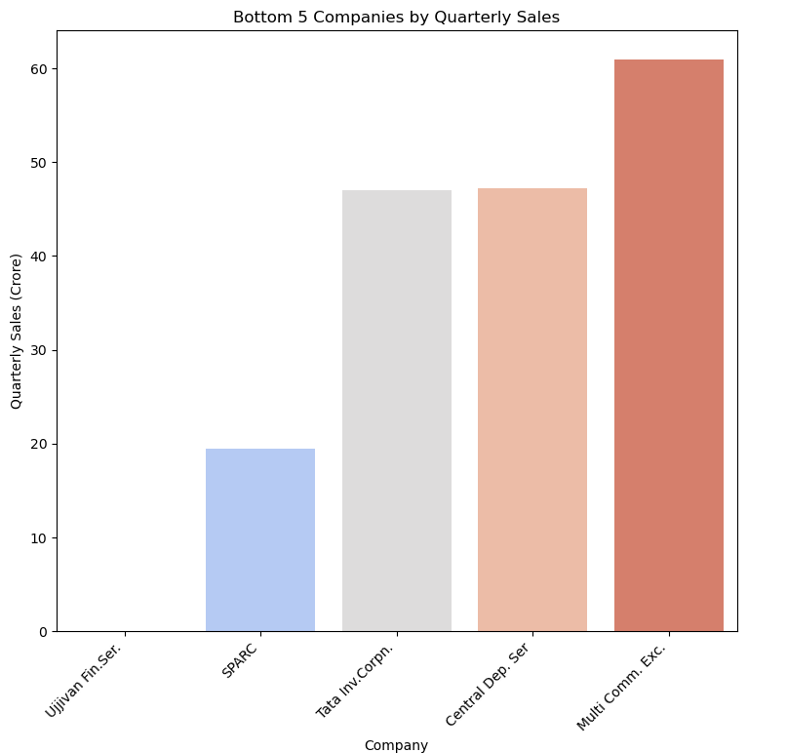
The least competition the project faces is from these bottom 5 companies, and there is no competition from Ujjivan.

Slide 10

Conclusion
As a result, I can conclude that the project faces the highest competition from IOCL, Reliance Industries, Tata Motors, BPCL, and HPCL. These are the top competitors that the team must address. On the other hand, the team faces less competition from Ujjivan, SPARC, Tata Investment Corporation, Central Deposition Services, and Multi Commodity Exchange.

